Slide 1
L7_Projection of Line 2
B. SANTHI
Assistant t Professor
Department of MECHANICAL Engineering
NIT Goa

Slide 2
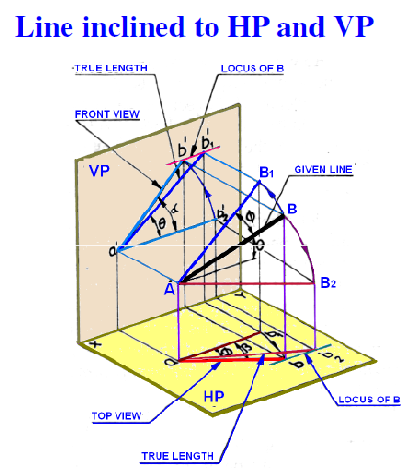
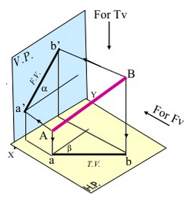

Slide 3
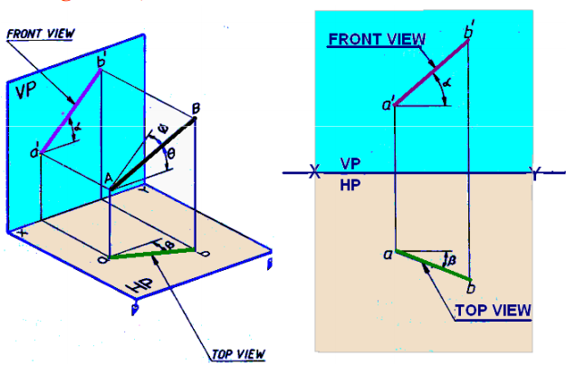
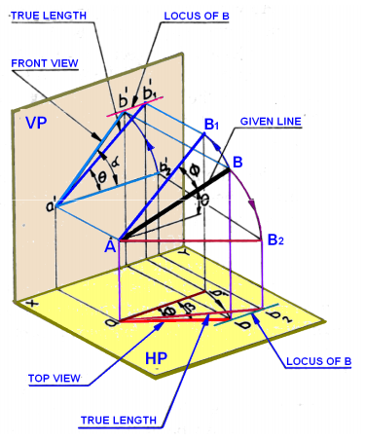
Line inclined to HP and VP
Apparent Inclinations: α and β Apparent Lengths: ab, a’b’

Slide 4
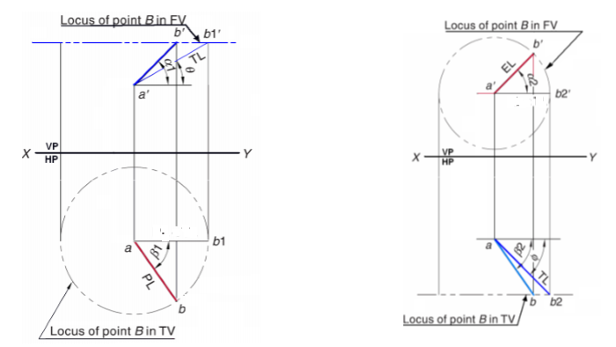
line AB is assumed to be made parallel to
VP and inclined at θ to HP.
line AB is assumed to be made parallel to HP and inclined at φ to VP

Slide 5
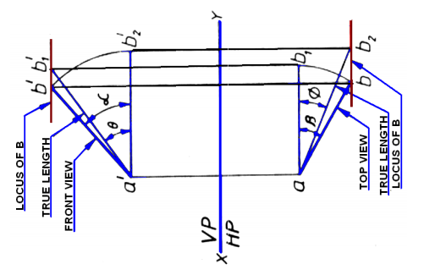

Slide 6
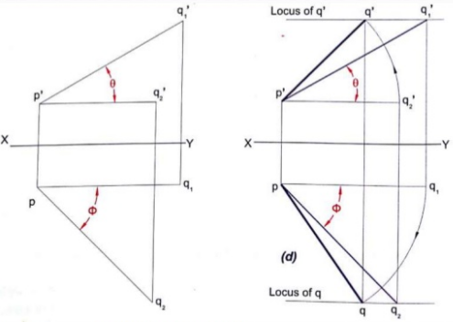

Slide 8
Thank You

